Slide 1

SOLID PRINCIPLES

Slide 2
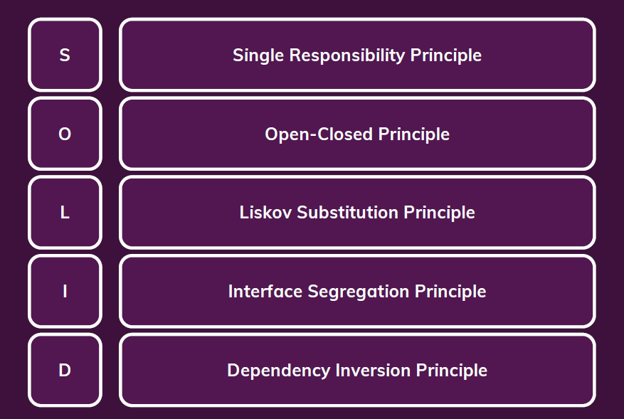
SOLID PRINCIPLES

Slide 3
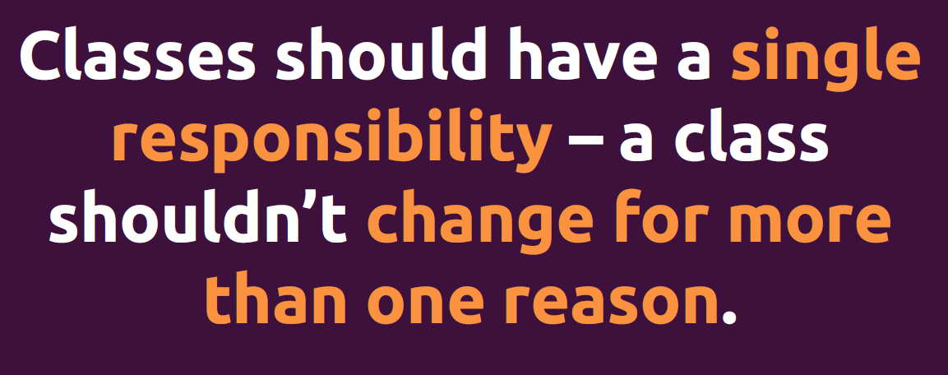
Single Responsibility Principle

Slide 4
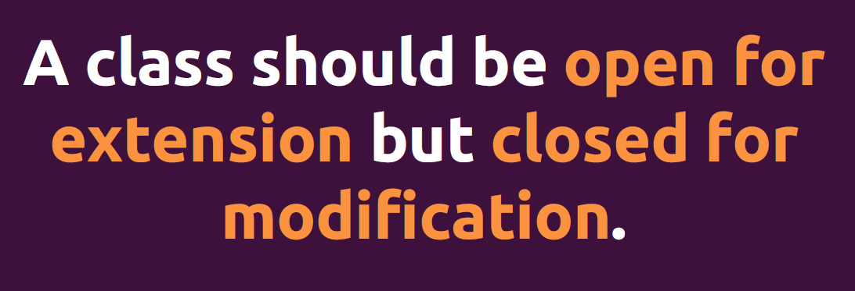

Open Closed Principle

Slide 5
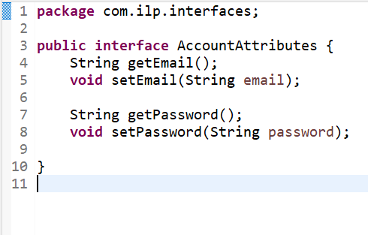
Single Responsibility Principle
The "AccountAttributes" interface adheres to SRP by defining methods solely related to managing account attributes (email and password). It encapsulates the responsibility of providing access to and modification of account information.

Slide 6
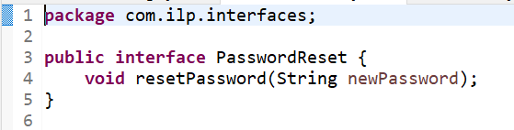
Single Responsibility Principle
Similar to AccountAttributes the PasswordReset interface follows SRP by providing methods specifically related to password reset functionality. It encapsulates the behavior related to resetting email and password.

Slide 7
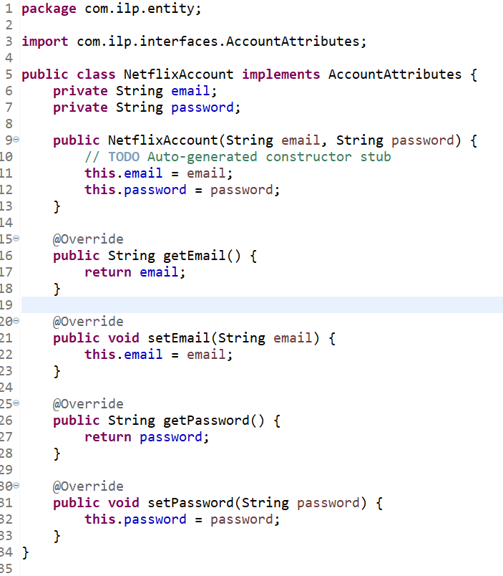
Single Responsibility Principle
The NetflixAccount class implements the AccountAttributes interface and is responsible for managing account attributes. It adheres to SRP by having a single responsibility related to handling account details.

Slide 8
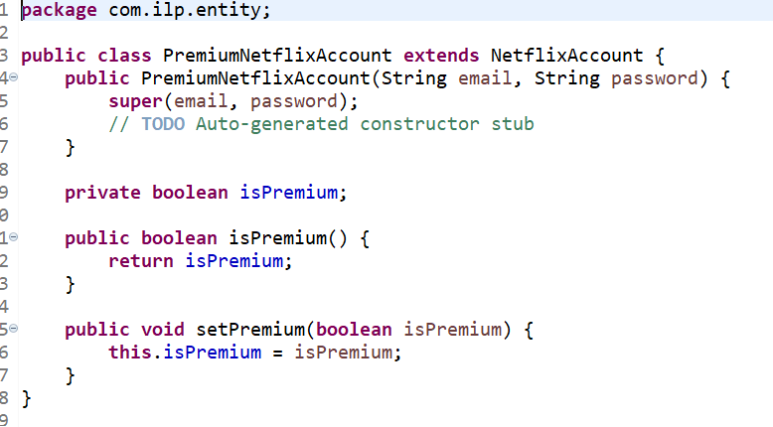
Open Closed Principle
Here the main class "NetflixAccount" is not modified rather a new attribute "isPremium" is added by extending it to a subclass "PremiumNetflixAccount".

Slide 9
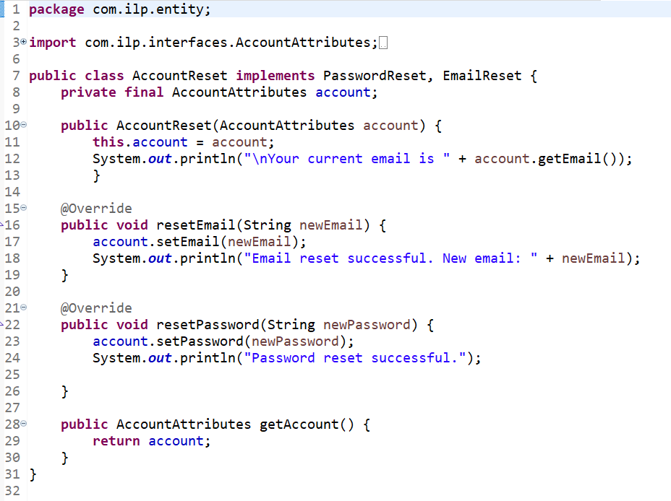
Open Closed Principle
The "AccountPasswordReset" class adheres to the OCP by being closed for modification (it doesn't need modification for new features related to account attributes) and open for extension (can be extended to implement additional interfaces or behaviors). It takes an "AccountAttributes" instance as a dependency through the constructor.

Slide 10
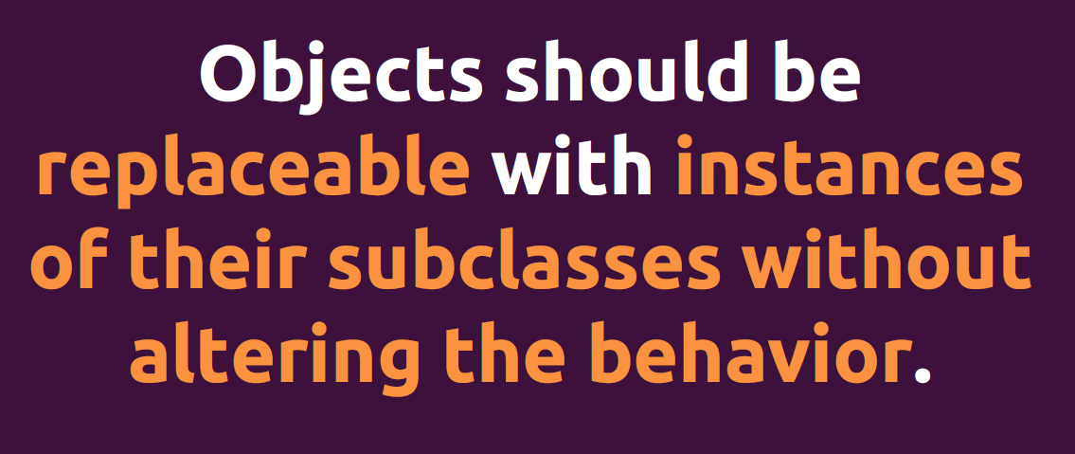
Liskov Substitution Principle

Slide 11
Liskov Substitution Principle

Slide 12
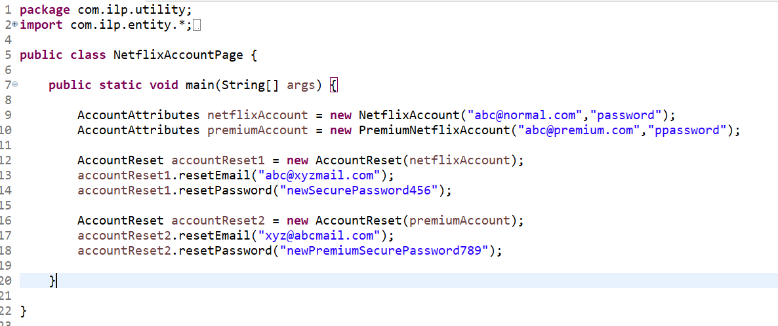
Liskov Substitution Principle
For Liskov Substitution Principle,the "PremiumNetflixAccount" class is a potential example. It is a subclass of "NetflixAccount" and should be substitutable for its base type without altering the correctness of the program.

Slide 13
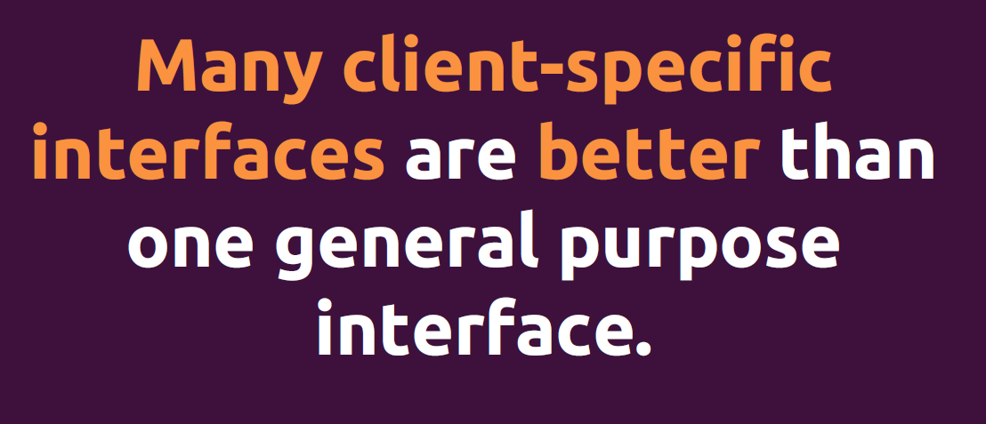
Interface Segregation Principle

Slide 14
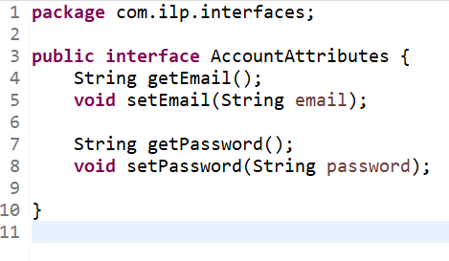
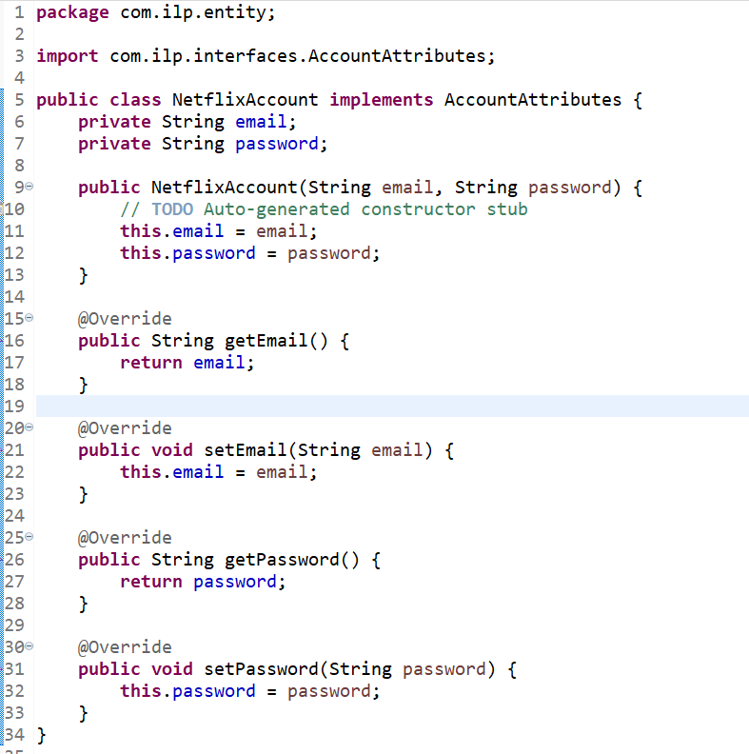
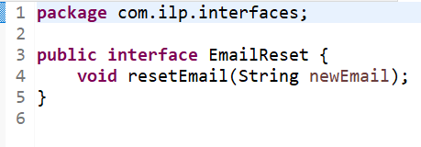
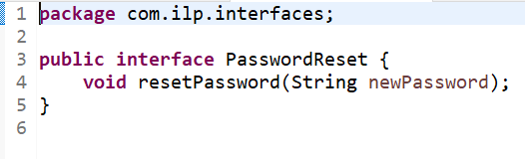
Interface Segregation Principle
The "NetflixAccount" class adheres to ISP by implementing only the methods relevant to account attributes and not being forced to implement unnecessary methods from other interfaces.

Slide 15
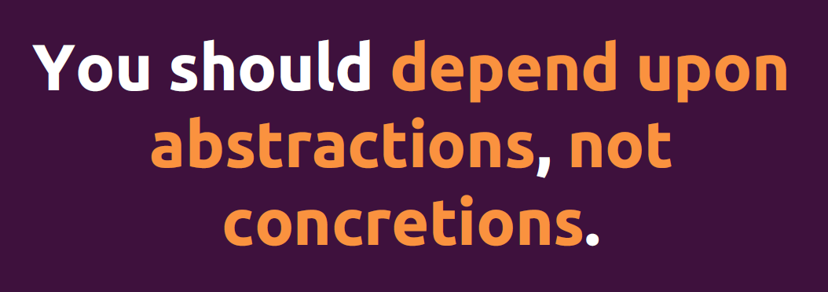
Dependency Inversion Principle

Slide 16
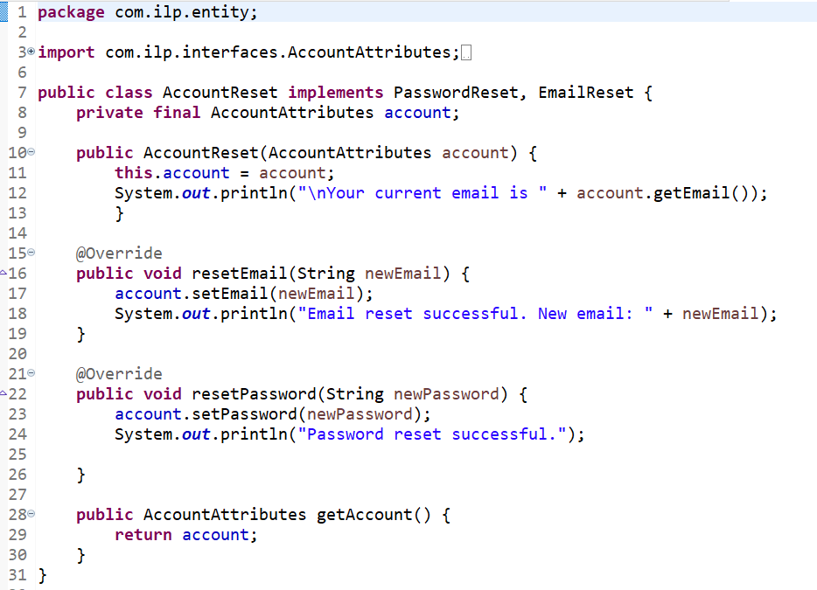
Dependency Inversion Principle

Slide 17
Dependency Inversion Principle
In the class "NetflixAccountPage", instances of "NetflixAccount" and "PremiumNetflixAccount" are created and passed as dependencies to the "AccountPasswordReset" class. This demonstrates the flexibility provided by Dependency Inversion. The high-level module (client code) injects the dependencies, and it is not tightly coupled to the specific implementations of AccountAttributes.

Slide 18
THANK YOU...

